Slide 1




Internship on Cloud Computing
RAJKIYA ENGINEERING COLLEGE BANDA
INFORMATION TECHNOLOGY
2021-2022 (15/09/2021 - 14/10/2021)
Submitted By –
AMAN VERMA 2007340139001
Submitted To –
DR. SIDDHARTHA ARJARIA
(ASSISTANT PROFESSOR
REC BANDA)

Slide 2
Abstract
Problem
As we all know that to setup a good hardware is very expensive and also we need a place to setup and good engineers to access the hardware . For a small as well as a big company this is very tremendous task.
Nowadays, there a lot of user access the websites/apps at same time due to this huge amount users websites/apps get crashed and unable to give the access to all the users.
Solution
We can use cloud technologies to solve these type of problems.
Cloud is virtual server which provide a platform to perform our computations according to our need. It is available in very affordable price compare to physical servers.

Slide 3
Used tools
Amazon Web Services
Windows 10
Linux
HTML, CSS, JAVASCRIPT
MariaDB

Slide 4
TOPIC
VIRTUAL MACHINES VS PHYSICAL SERVERS
AMAZON VIRTUAL PRIVATE CLOUD(AMAZON VPC)
SHARED RESPONSIBILITY MODEL
WHAT IS SERVERLESS COMPUTING
SERVERLESS APPLICATION USE CASES
AMAZON ELASTIC COMPUTE CLOUD(AMAZON EC2)
BENEFITS OF EC2
AMAZON EC2 PRICING
ELASTIC LOAD BALANCING(ELB)
AWS LAMBDA
AMAZON S3
CHOOSING A REGION
AMAZON S3 GLACIER
AMAZON ELASTIC BLOCK STORE(AMAZON EBS)
AWS IDENTITY AND ACCESS MANAGEMENT(IAM)
AMAZON S3 ACCESS CONTROL : GENERAL
AWS DATABASE OPTIONS

Slide 5




Virtual machines vs. physical servers
Amazon EC2 can solve some problems that are more difficult with an on-premises server
When using disposable resources
Data-driven decisions
Quick iterations
Free to make mistakes

Slide 6
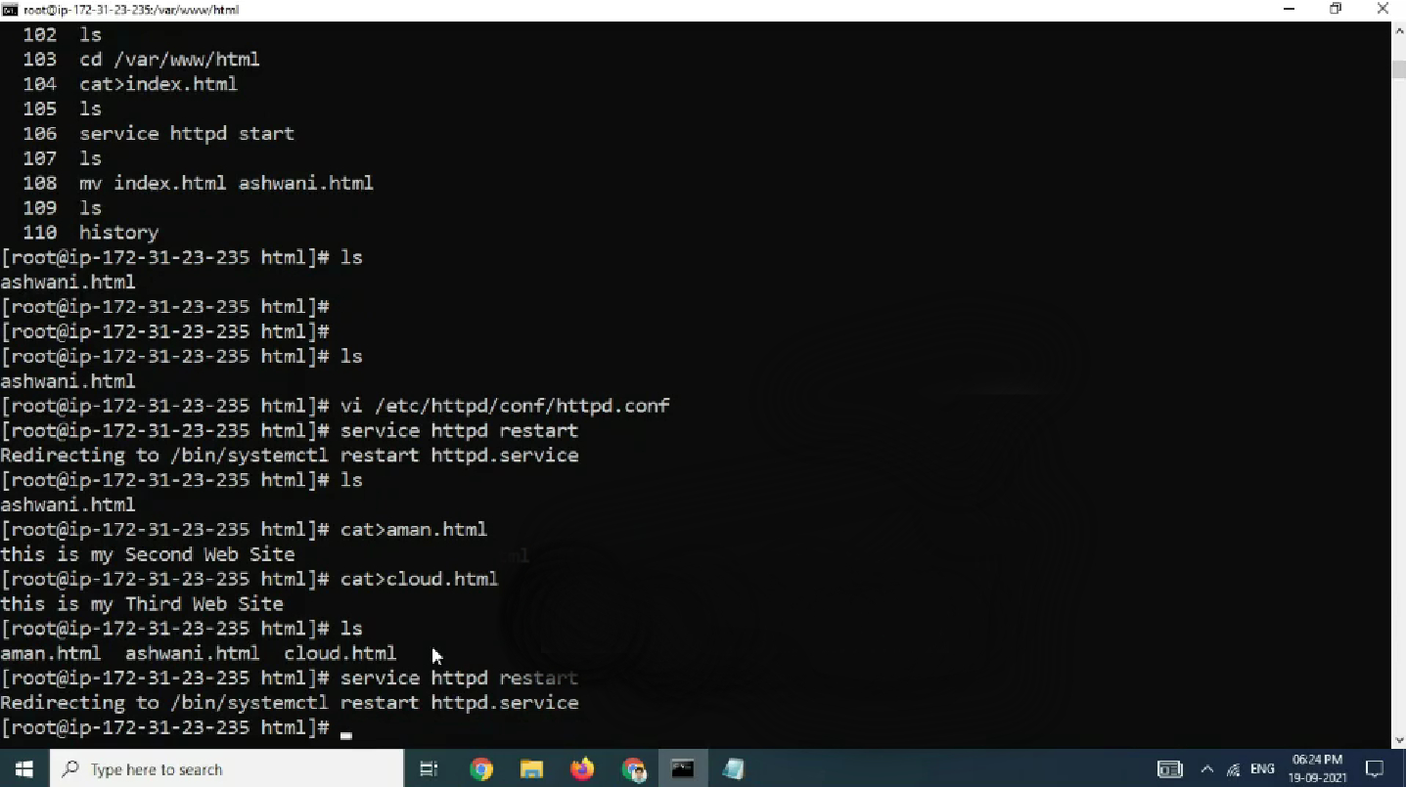

Creating virtual server in Windows
Creating virtual server in Linux

Slide 7




Amazon Virtual Private Cloud (Amazon VPC)
Amazon VPC
AWS Cloud
VPC
Dev
Test
Your private network space in the AWS Cloud
Provides logical isolation for your workloads
Allows custom access controls and security settings for your resources

Slide 8
Shared responsibility model
Customer data
Platform, applications, identity and access management
Customer responsibility
Operating system, network, and firewall configuration
Client-side data encryption and data integrity authentication
Server-side encryption (file system and/or data)
Network traffic protection (encryption, integrity, identity)
AWS foundation services
Compute
Storage
Databases
Networking
AWS
responsibility
AWS global infrastructure
Regions
Availability Zones
Edge locations

Slide 9




What is serverless computing?
Building and running applications and services without managing servers
No servers to
provision or manage
Scales
with usage
Never pay
for idle
Availability and
fault tolerance built in

Slide 10






Serverless application use cases
Web applications
Static websites
Complex web applications
Packages for Flask and Express
Data
processing
Real time MapReduce Batch
Machine learning inference
Amazon
Alexa
Powering voice-enabled applications
Alexa
Skills Kit
IT
automation
Policy engines
Extending AWS services
Infrastructure management
Backends
Applications
and services
Mobile IoT
Chatbots
Powering
chatbot logic

Slide 11
Amazon Elastic Compute Cloud (Amazon EC2)
Resizable compute capacity
Complete control of your computing resources
Reduced time required to obtain and boot new server instances
Amazon EC2

Slide 12








Amazon EC2
Amazon EC2 provides pay-as-you-go pricing and a broad selection of hardware and software
Use Amazon Machine Images (AMIs)
Add or terminate instances as needed
Pause and resume your instances
Template for
Storage volumes
Launch permissions
A block device mapping
Your AMI
Examples
Instance | Instance | Instance
Instance | Instance | Instance
Instance | Instance | Instance
Application server
Web server
Database server
Game server
Mail server
Media server
Catalog server
File server

Slide 13
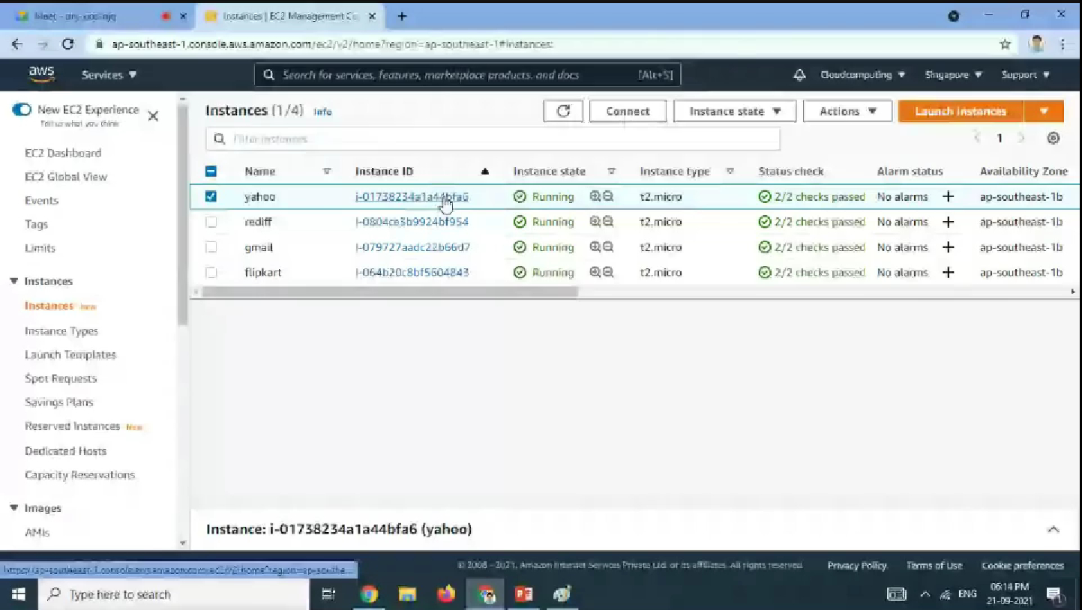
Creating different instances

Slide 14
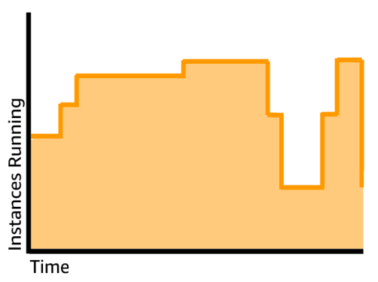
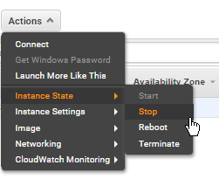
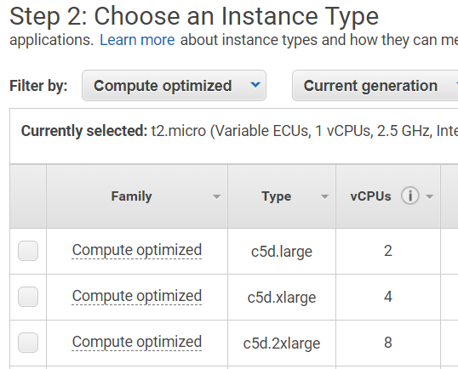

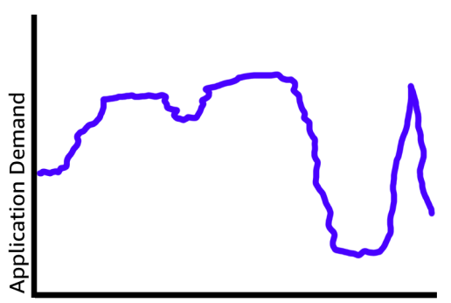




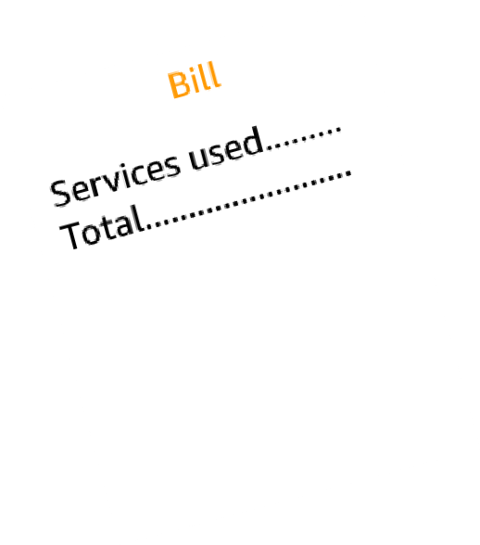







Benefits of Amazon EC2
VPC
Auto Scaling
ELB
Elasticity
Control
Flexibility
Integrated
Reliable
Secure
Inexpensive
Easy

Slide 15
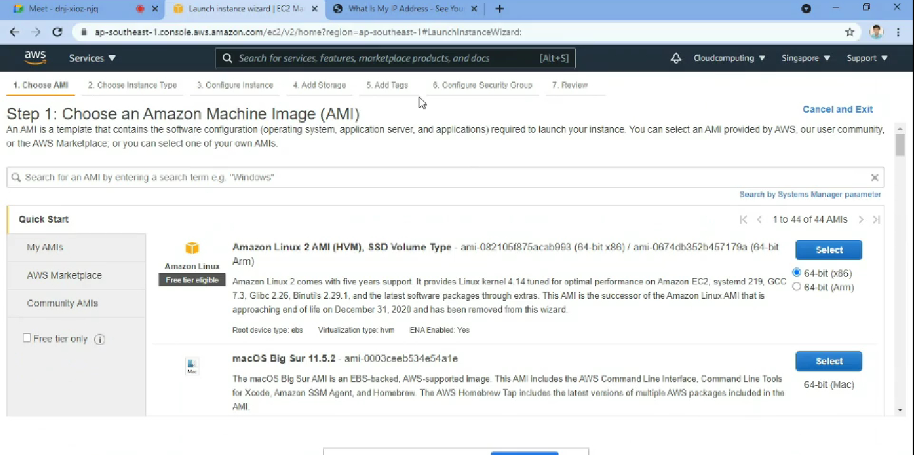
Choosing instances according our need

Slide 16
Amazon EC2 pricing
On-Demand
Instances
Reserved
Instances
Savings
Plans
Spot
Instances
Per-second billing (Amazon Linux and Ubuntu only)
Per-hour billing (all other OS)

Slide 17
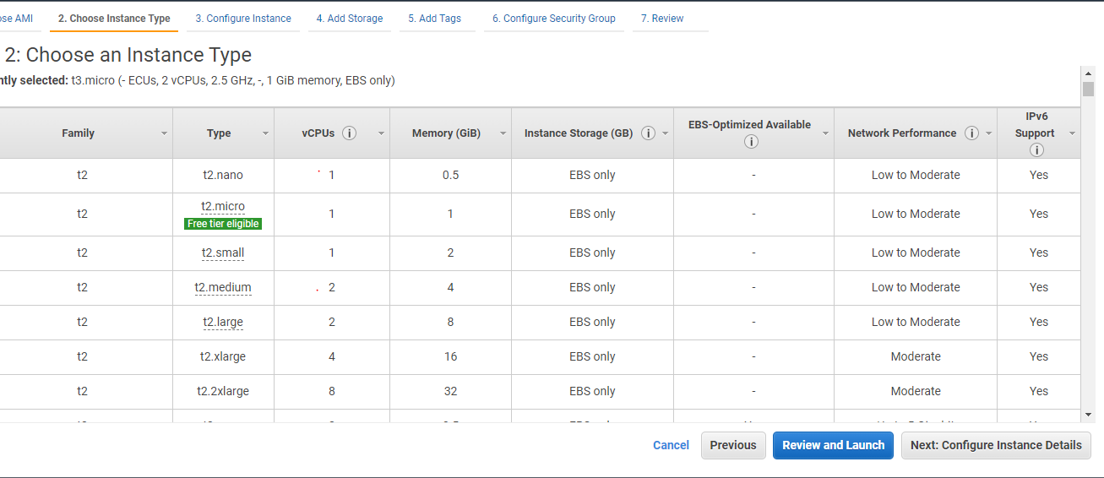
We can buy instance type according to our need

Slide 18
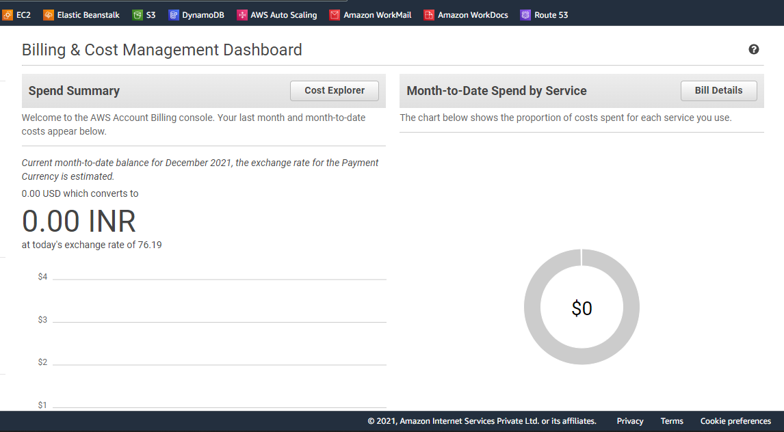
Billing And Cost Management Dashboard

Slide 19






Elastic Load Balancing (ELB)
Elastic Load Balancing
A managed load balancing service that distributes incoming application traffic across multiple Amazon EC2 instances, containers, and IP addresses.
High availability
App
Health checks
App
Security features
ELB
App
User traffic

Slide 20







Putting it all together
Amazon
Route 53
AWS Cloud
Amazon EC2 Auto Scaling group
Clients
Internet gateway
ELB
EC2 instances

Slide 21

AWS Lambda
Fully managed compute service
Runs stateless code
Supports multiple languages
Runs your code on a schedule or in response to events (e.g., changes to data in an Amazon S3 bucket or Amazon DynamoDB table)
AWS
Lambda

Slide 22




Amazon S3
Use cases
Content storage and distribution
Backup and archiving
Big data analytics
Disaster recovery
Static website hosting
Amazon S3
Object-level storage
Designed for
99.999999999%
durability
Event triggers

Slide 23





Amazon S3
Built to store and retrieve data
Fast, durable, highly available access to objects
Can store an unlimited number of objects in a bucket
Store and retrieve data at any time, from anywhere on the web
Client
Client sends request to S3 →
Amazon S3 bucket
← Object returned

Slide 24
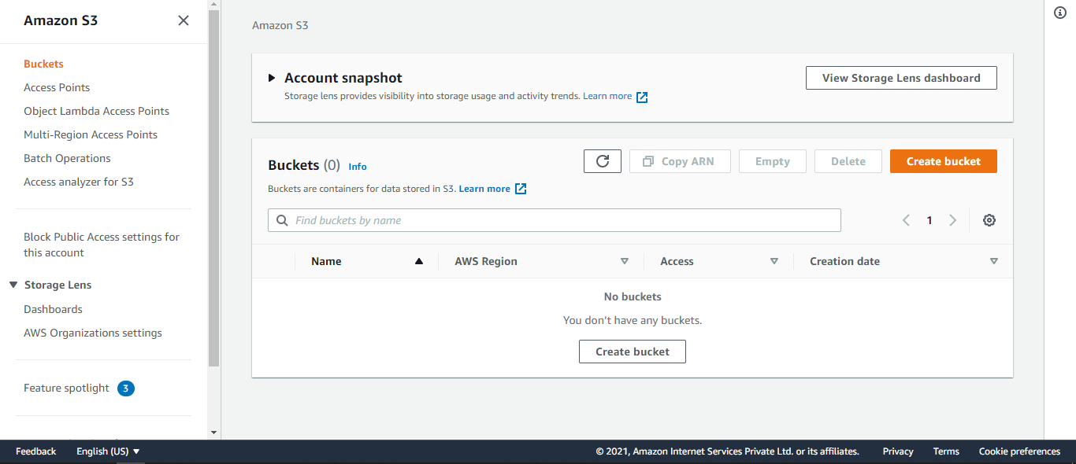
Creating S3 storage

Slide 25
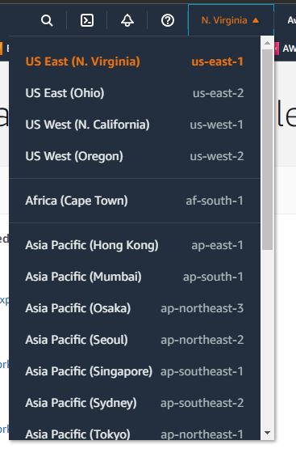
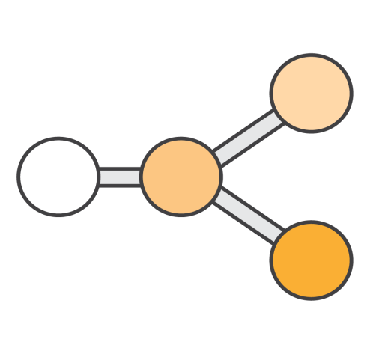



Choosing a Region
Data residency regulatory compliance
Proximity of users to data
Cost- effectiveness
$
$$
Are there relevant Region
data privacy laws?
Small differences in latency can impact customer experience
Costs vary by Region
Evaluate cost-effectiveness of replicating data to another Region
Can customer data be stored outside the country?
Choose the Region
closest to your users

Slide 26




Amazon S3 Glacier
Amazon S3 Glacier
Long-term data storage
Use cases
Media asset workflows
Healthcare information archiving
Regulatory and compliance archiving
Scientific data storage
Digital preservation
Magnetic tape replacement
Archival & backup
Very low-cost storage

Slide 27









Amazon Elastic Block Store (Amazon EBS)
Persistent block storage for instances
Protected through replication
Different drive types
Scale up or down in minutes
Pay for only what you provision
Snapshot functionality
Encryption available
AWS Cloud
Monday’s snapshot Tuesday’s snapshot Wednesday’s snapshot
Thursday’s snapshot Friday’s snapshot
EC2
instance
EC2
instance
Amazon EBS Volumes
Create volume snapshots for backup and recovery
Detach and reattach volumes to other EC2 instances

Slide 28

AWS Identity and Access Management (IAM)
Securely control access to your AWS resources
Assign granular permissions to users, groups, or roles
Share temporary access to your AWS account
Federate users in your corporate network or with an internet identity provider
IAM

Slide 29




IAM components
Create
Users
A person or application that interacts with AWS
Groups
Collection of users with
identical permissions
Roles
Temporary privileges that an entity can assume
Defines permissions to control which AWS
resources users can access
Helps you to meet identity and access control standards
Authentication
Authorization
IAM
Permissions
Policies

Slide 30







Amazon S3 access control: General
Some services support resource-based policies, such as S3 bucket policies
Default Public Access policy
Owner Owner Owner User A
Controlled
access
Private
Public
Anyone
else
Anyone
else
User B

Slide 31





AWS database options
SQL
NoSQL
Transactional
databases
Amazon RDS
Amazon DynamoDB
Data analytics or relationships
Amazon Redshift Amazon Neptune
In-memory data
store and cache
Amazon ElastiCache

Slide 32
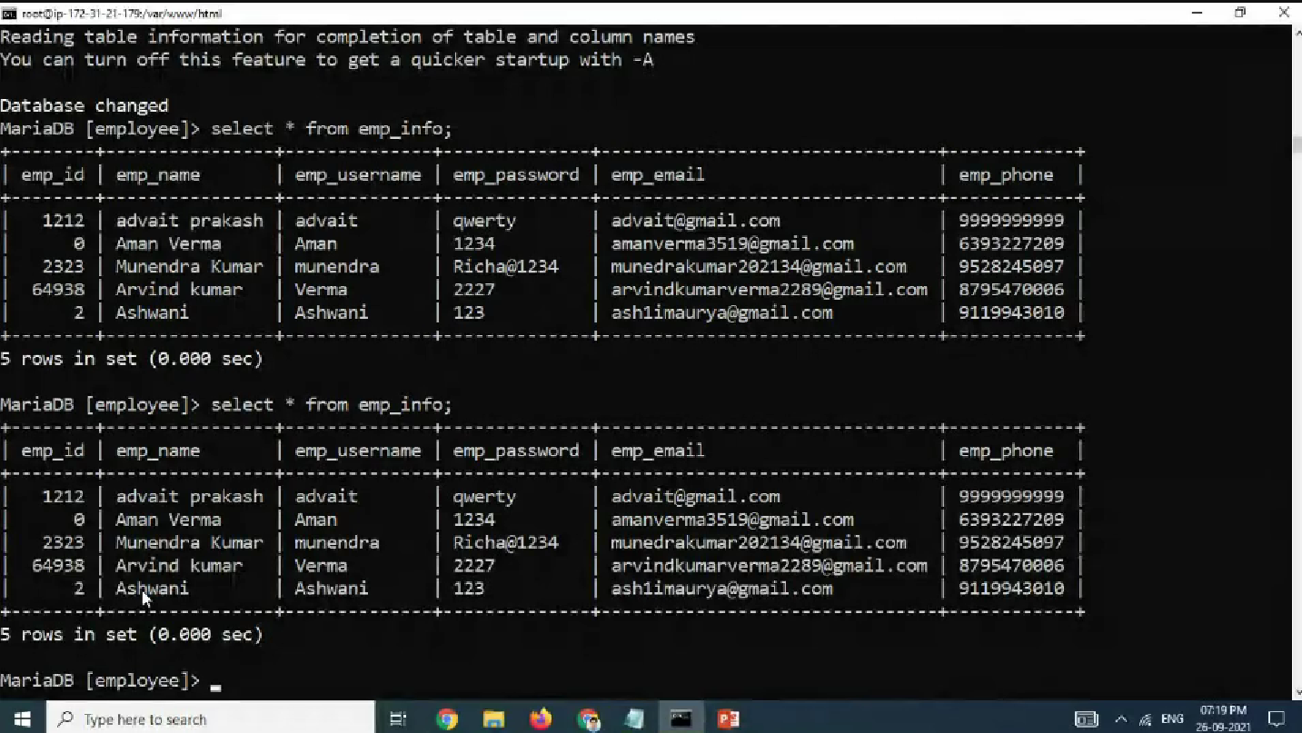
Creating Database using MariaDB

Slide 33

Thank you!

